Slide 1

AIRBNB HOTEL BOOKING ANALYSIS
[Name: Vaishnavi Shatagopam]
[AICTE Internship ID:STU66421c8ff198c1715608719]

Slide 2

PROBLEM STATEMENT
This research project aims to conduct an in-depth analysis of the New York City Airbnb dataset to extract meaningful insights into the city's dynamic short-term lodging market. By employing rigorous data cleaning, exploratory analysis, and visualization techniques, the study will identify key trends and patterns. The core focus is on discerning the factors that influence listing availability, pricing strategies, and overall customer satisfaction. This analysis will contribute to a deeper understanding of Airbnb's operational model in a major urban environment. Ultimately, the findings will provide valuable insights for stakeholders seeking to navigate the evolving accommodation landscape.

Slide 3
Project Description
This project provides a comprehensive analysis of the New York City Airbnb dataset to uncover key insights into the urban short-term rental market. By employing rigorous data cleaning, exploratory analysis, and visualization techniques, the study aims to understand the core dynamics influencing lodging availability, pricing, and customer satisfaction. The research specifically investigates the distribution of property types across different neighborhoods, identifies which areas command the highest prices, and explores the relationship between factors like host verification and positive reviews. It will also determine the top-performing hosts based on listing volume and examine the correlation between a listing's price and its associated service fee. Ultimately, the goal is to distill complex data into a clear understanding of Airbnb's operations, providing valuable insights for all stakeholders involved in this evolving industry.

Slide 4

WHO ARE THE END USERS?
Based on the context of the Airbnb Hotel Booking Analysis project, the end users and primary stakeholders who would benefit from these insights can be categorized as follows:
Current and Potential Airbnb Hosts: They can use the analysis to make data-driven decisions on pricing strategies, identify high-demand neighborhoods to invest in, understand which property types are most popular, and learn how to optimize their listings to attract more guests and receive better reviews.
Travelers and Guests: While not direct users of the analysis, they are the ultimate beneficiaries of tools or articles derived from it. The insights can help them find the best value, understand pricing trends across the city, and identify reputable hosts, leading to better and more informed booking decisions.
Airbnb (The Company): The platform itself is a key end user. The analysis provides crucial business intelligence for market strategy in New York City, helping them understand user behavior, identify areas for growth, and make informed decisions about platform policies and service fees.
Real Estate Investors and Property Managers: This group can leverage the insights to identify profitable investment opportunities in the short-term rental market. The data on high-yield neighborhoods and in-demand property types is essential for maximizing their return on investment.
Urban Planners and Policymakers: City officials and local government bodies can use this data to understand the impact of short-term rentals on the housing market, tourism, and regional economy, which helps in formulating effective and fair regulations.

Slide 5

Technology Used
Programming Language:
Python: The core programming language used for all data manipulation and visualization tasks in the notebook.
Environment:
Google Colab: The notebook was run in a Google Colab environment, as indicated by the use of Colab-specific code to upload files (from google.colab import files).
Jupyter Notebook: The .ipynb file format itself shows that the analysis was conducted in an interactive Jupyter Notebook environment.
Key Python Libraries:
Pandas: This was the primary library for data analysis. It was used to load the dataset from an Excel file, inspect the data using .info() and .describe(), group the data to calculate averages, and obtain value counts for various columns.
Matplotlib & Seaborn: These libraries were used for all the data visualizations. The notebook specifically uses them to create bar plots, count plots, scatter plots, and box plots to analyze different aspects of the data.
Openpyxl: This library was installed to enable Pandas to read the .xlsx data file.

Slide 6
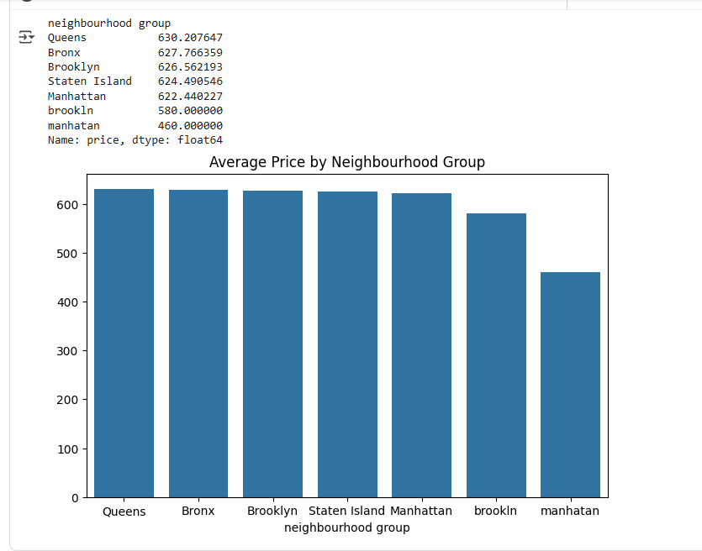
RESULTS1
Demo Link

Slide 7
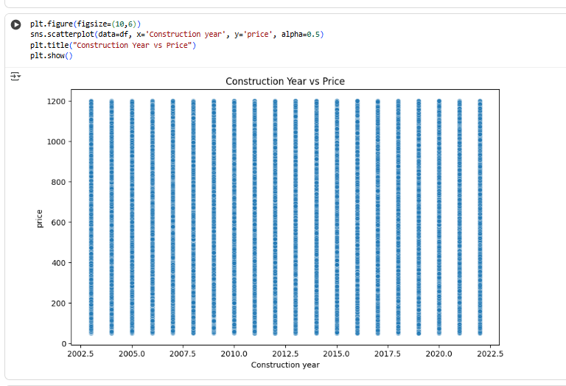
RESULTS2
Demo Link

Slide 8
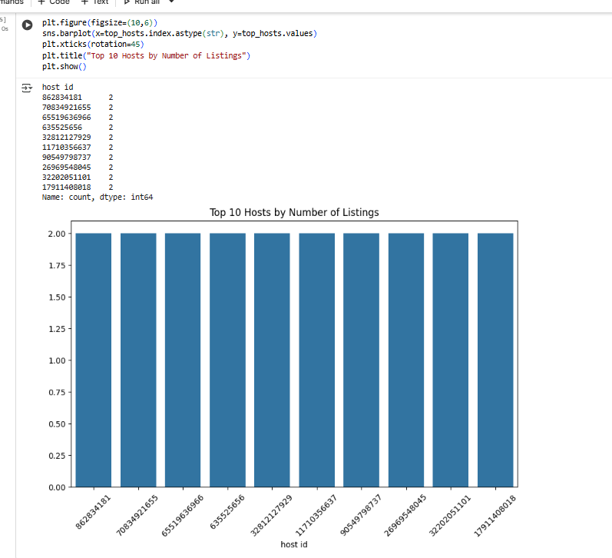
RESULTS3
Demo Link

Slide 9
GitHub repository
[Add the working url of your github repository ]
Create github repository with format VOIS_AICTE_Oct2025_YourName
Demo Link

Slide 10
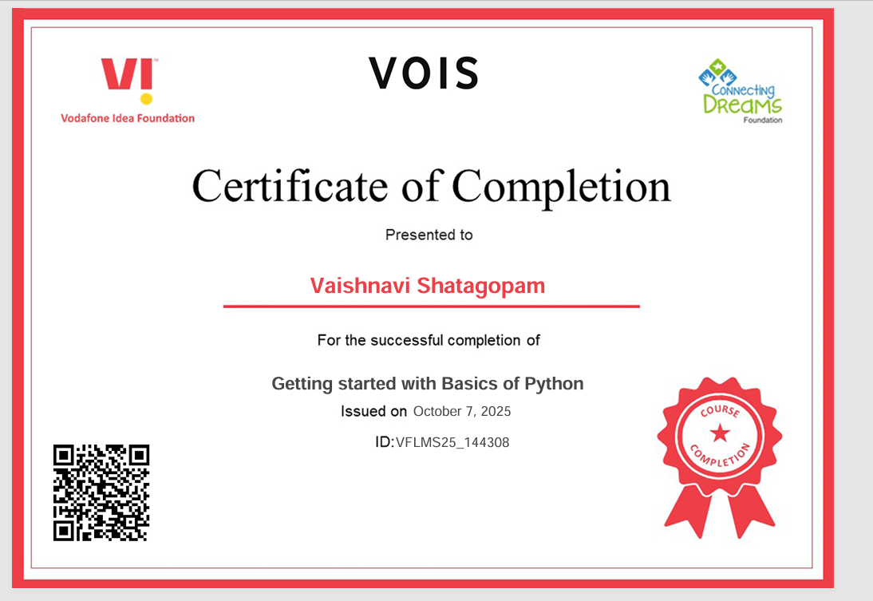
Getting started with Basics of Python Certificate

Slide 11
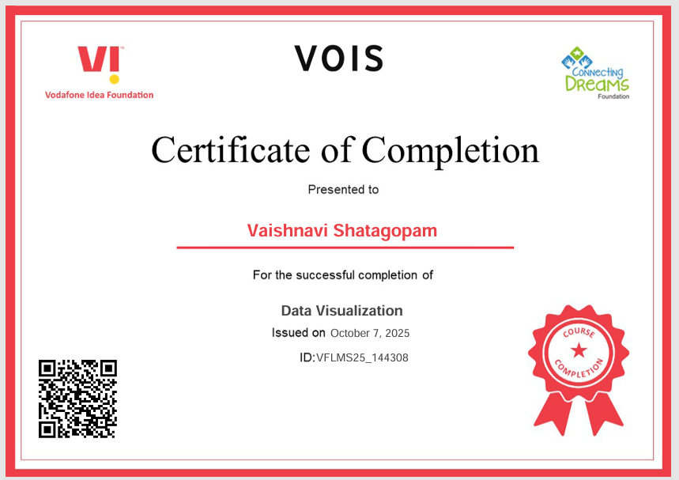
Data Visualization Certificate

Slide 12
Thank you
.
.

